Slide 1

Embedded System
Mohammad Baher
Hussien Rida
Mohammad Jawad Rmeity

Slide 2
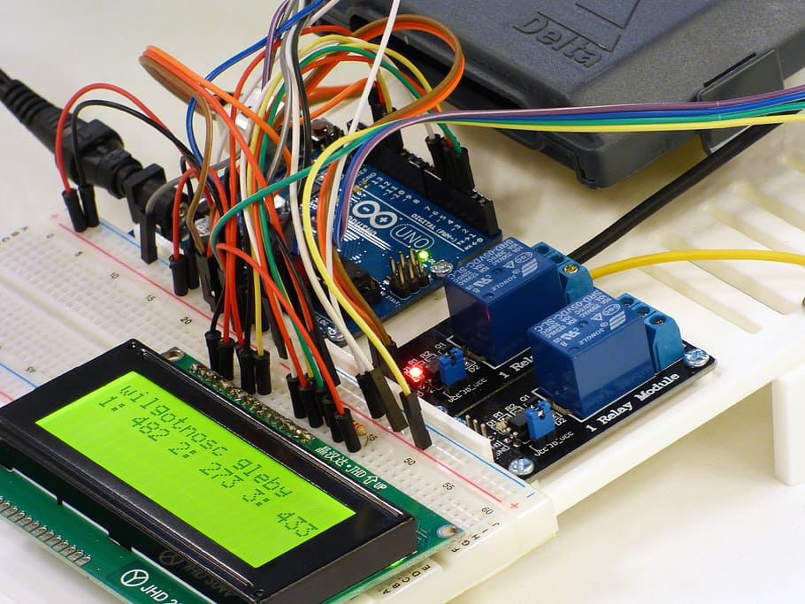
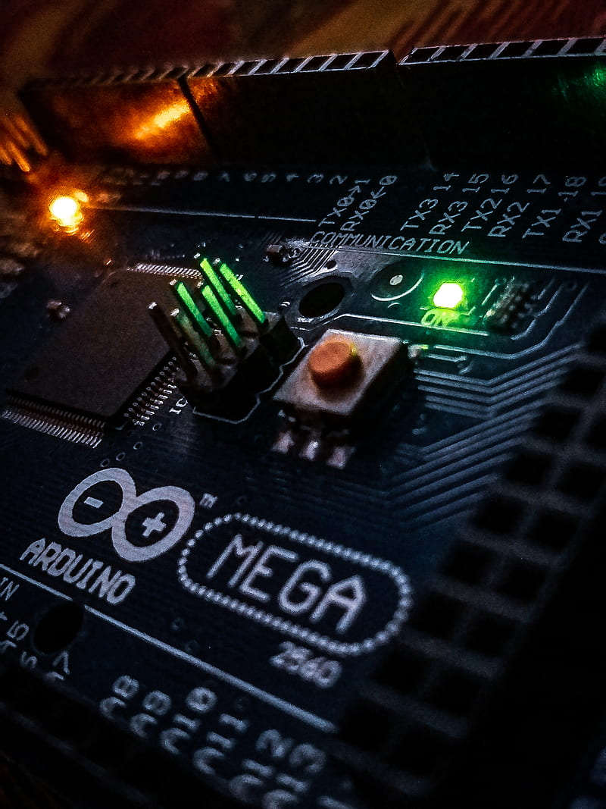
Introduction
Drowsy driving is one of the leading causes of road accidents worldwide. Long hours behind the wheel can cause fatigue, reducing a driver's alertness and reaction time. To help prevent accidents caused by sleepiness, an Anti-Sleep Alarm Detector is designed to monitor signs of drowsiness and alert the driver before they fall asleep. These systems typically use sensors to detect head movements, eye closure, or changes in driving patterns, and trigger an alarm or vibration to wake the driver up. By providing timely alerts, this device enhances road safety and can potentially save lives.

Slide 3
Main Components:
Hardware Components:
Microcontroller (e.g., Arduino, Raspberry Pi, ESP32): Acts as the brain of the system, processing sensor data and controlling alerts.
Camera or IR5 Sensor Module (for eye/blink detection): Tracks eye movement or detects when the eyes are closed for too long.
Accelerometer/Gyroscope Sensor (optional): Detects sudden head tilts or nodding, which are common signs of drowsiness.
Buzzer or Alarm Module: Emits a sound to wake the driver when drowsiness is detected.
Vibration Motor (optional): Provides a physical alert through vibration, often used in wearables or seat attachments.
Power Supply (Battery or USB): Powers the entire system.
Display Module (optional, e.g., OLED/LCD): Shows real-time data or status messages.

Slide 4
Main Components:
Software Components:
Computer Vision Library (e.g., OpenCV): Used for eye detection, blink rate monitoring, or facial landmarks (if using a camera).
Microcontroller Code (C/C++ or Python): Controls sensors and handles logic for drowsiness detection and triggering alarms.
Machine Learning Model (optional): For more advanced detection, such as identifying drowsiness patterns from facial expressions or behavior.

Slide 5
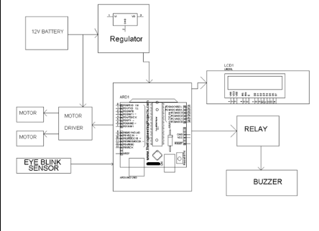
Block Diagram

Slide 6
Main Components in the Diagram:
Eye Blink Sensor:
Detects the driver's eye activity to determine drowsiness.
Connected to the microcontroller (Arduino) for processing.
Arduino (ARD1):
Central microcontroller that processes signals from the eye blink sensor.
Sends commands to output components based on the detection logic.
Relay & Buzzer:
The relay acts as a switch to activate the buzzer.
The buzzer sounds an alarm when drowsiness is detected.
LCD Display (LCD1):
Displays real-time status or messages (like "Driver Drowsy").
Motor Driver & Motors:
These seem to be additional components (possibly for vibrating feedback or demonstration purposes).
Controlled via the Arduino.
Regulator:
Manages voltage from the 12V battery to ensure safe power levels for the Arduino and components.

Slide 7
Schedule working
Phase 1: Research and Design (Week 1-2)
Study drowsiness detection methods (eye blink, head tilt, facial recognition)
Select suitable sensors and hardware (e.g., eye blink sensor, camera module, Arduino)
Design system architecture and block diagram
Phase 2: Hardware Prototyping (Week 3-4)
Assemble core hardware components (microcontroller, sensors, buzzer, display)
Test individual components: eye blink sensor, buzzer, LCD, power supply
Build basic circuit and integrate sensors with Arduino
Phase 3: Core Software Development (Week 5-6)
Develop microcontroller code (C/C++) to read sensor inputs
Implement alarm triggering logic
Add basic user feedback via buzzer and LCD

Slide 8
Phase 4: Machine Learning & Computer Vision (Week 7-8)
Integrate OpenCV for camera-based drowsiness detection (if applicable)
Train or apply ML model to detect eye closure or facial expressions
Test performance of combined sensor and ML-based detection
Phase 5: System Integration and Refinement (Week 9-10)
Combine all modules into a final system
Optimize detection accuracy and alarm responsiveness
Conduct real-world testing and refine based on feedback
Finalize the prototype enclosure and documentation

Slide 9
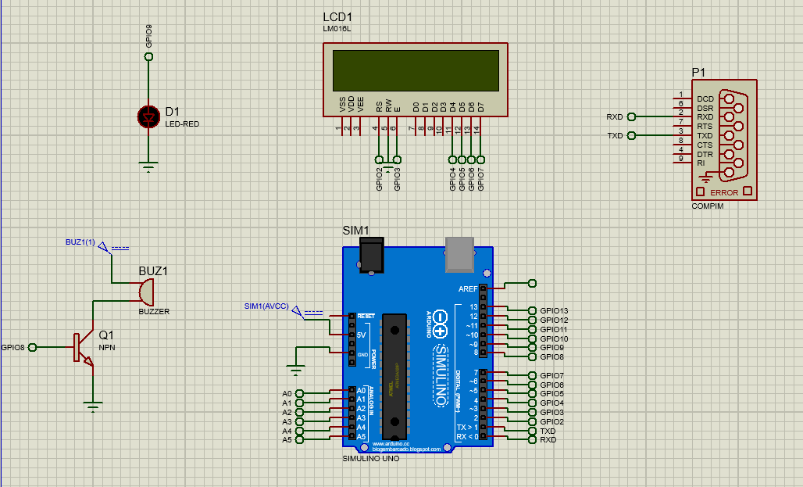
circuit design

Slide 10
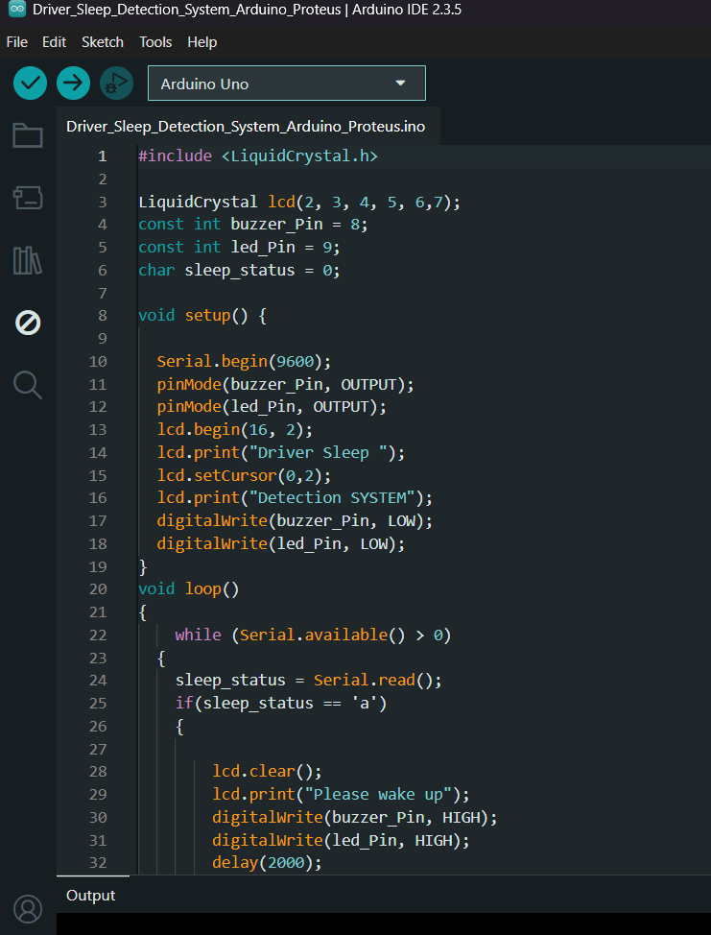
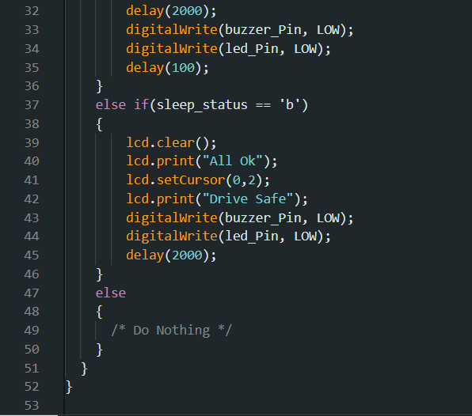
Arduino Code

